Slide 1
Data Visualisation

Slide 2


Slide 3
Content
General data visualisation tips
Visualising Data in R with ggplot2

Slide 4

Notes:
Say that the tips we are getting are from Edward Tufte.

Slide 5
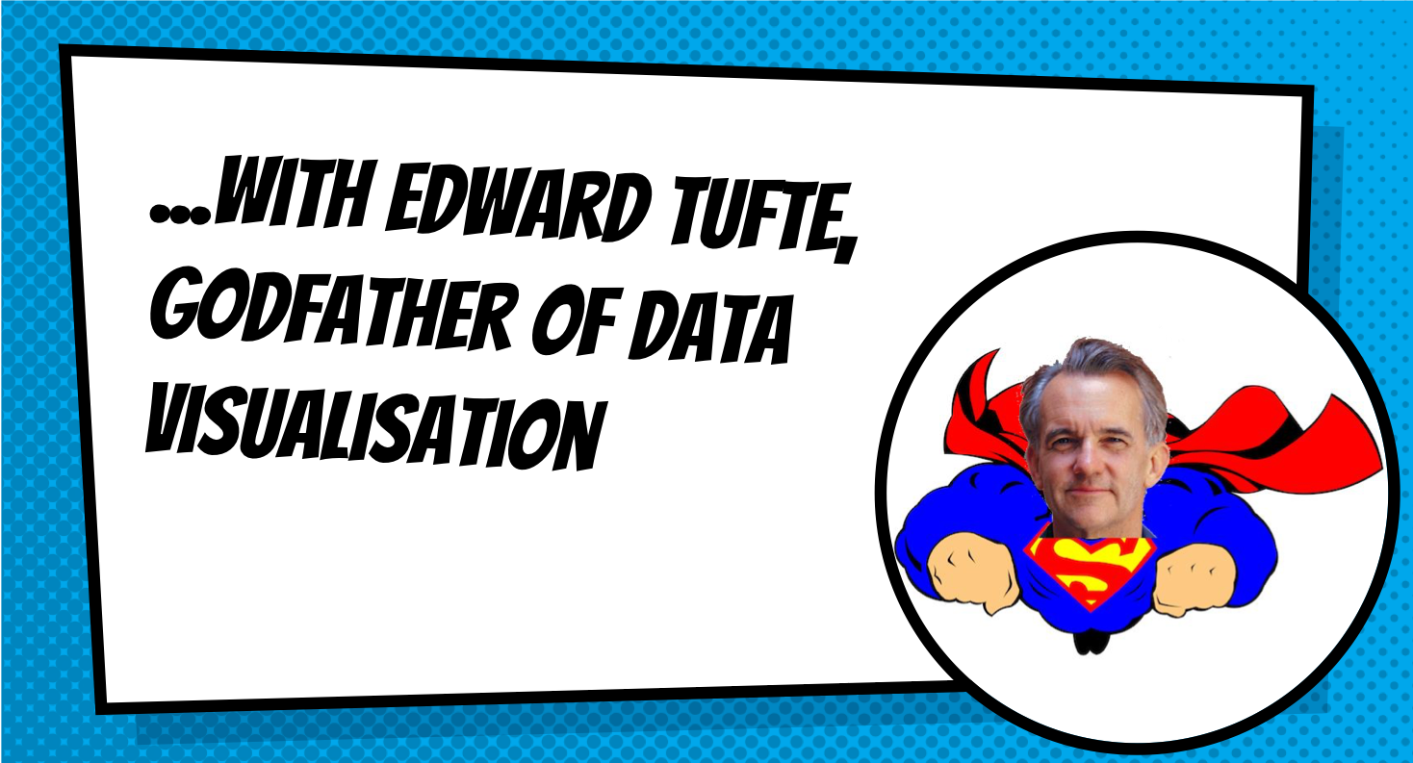

Slide 6
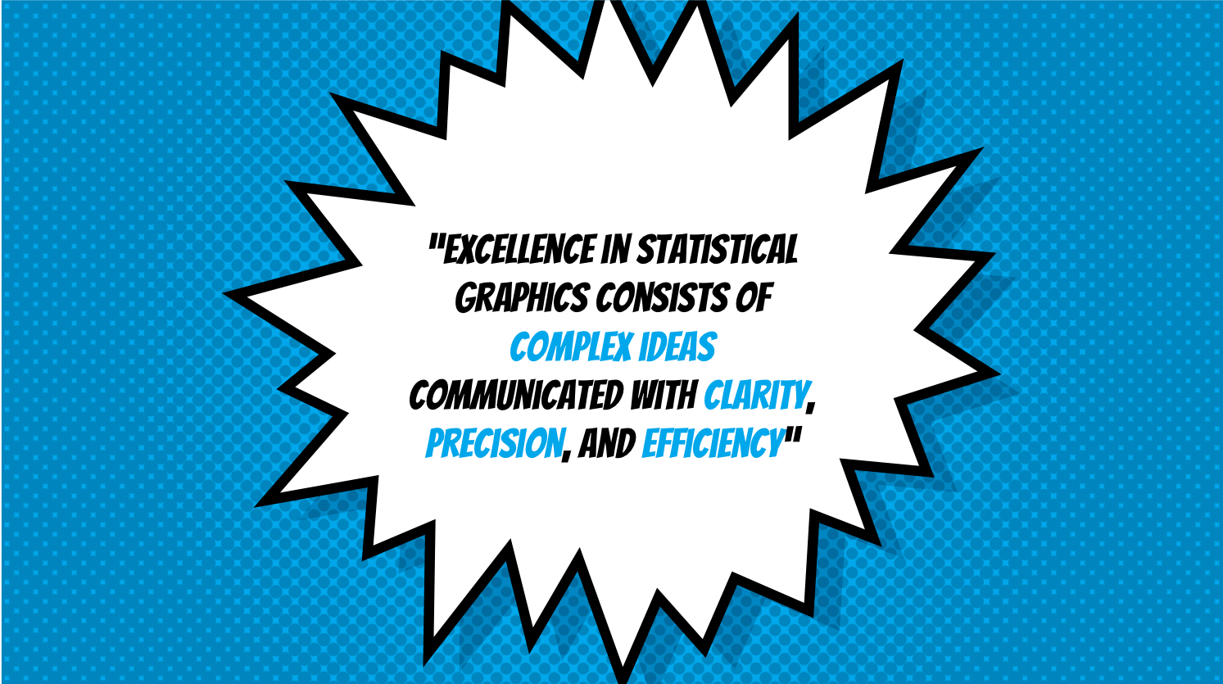

Slide 7
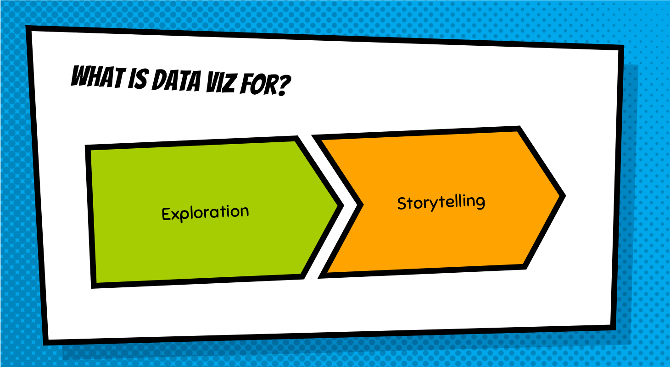

Slide 8


Slide 9
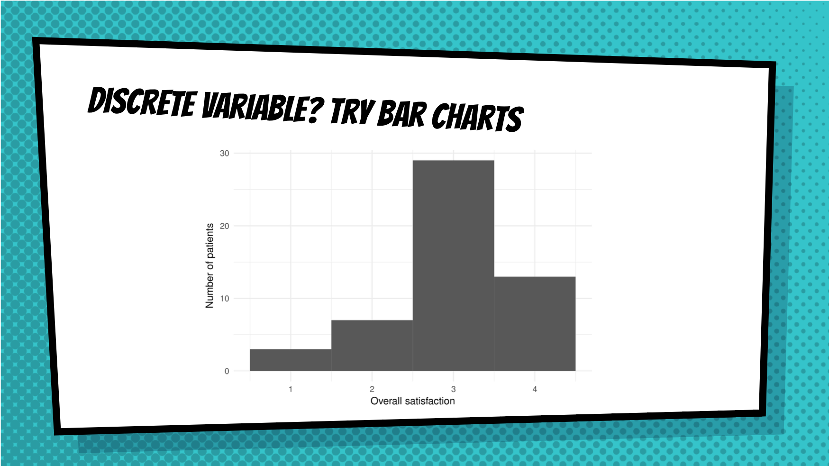

Slide 10
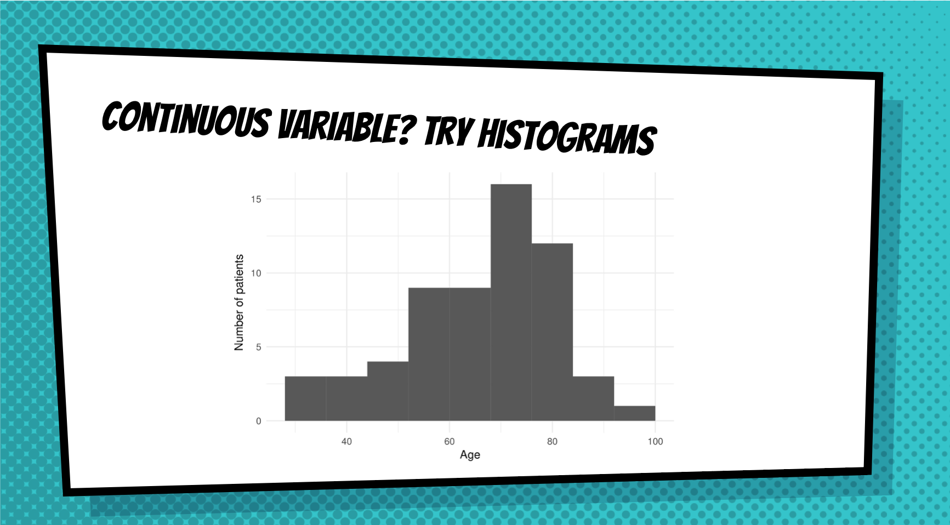

Slide 11
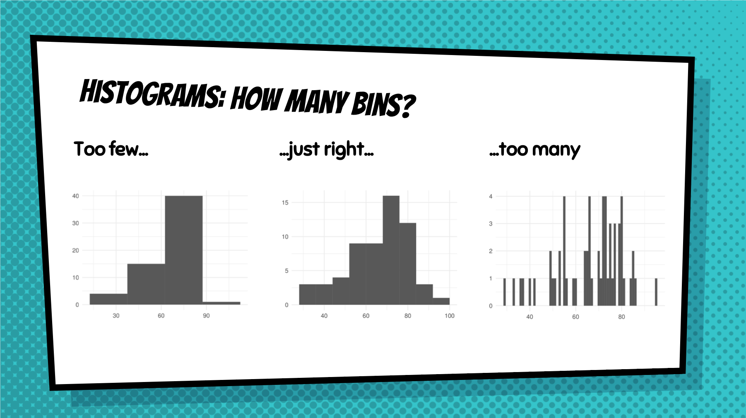

Slide 12
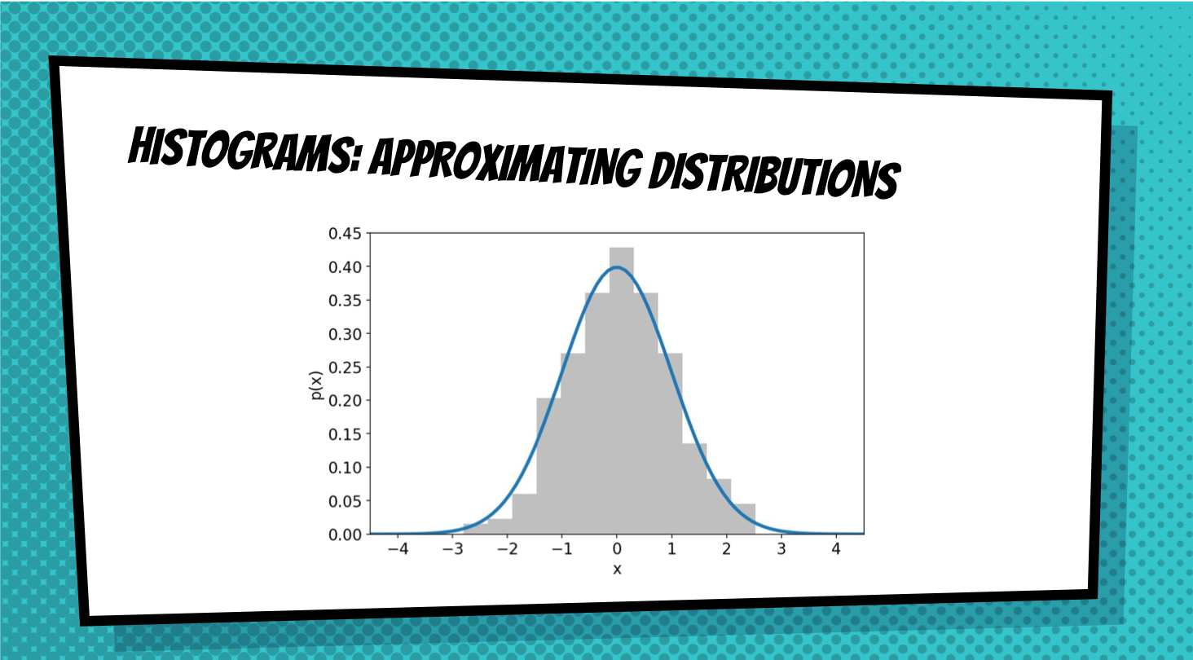

Slide 13
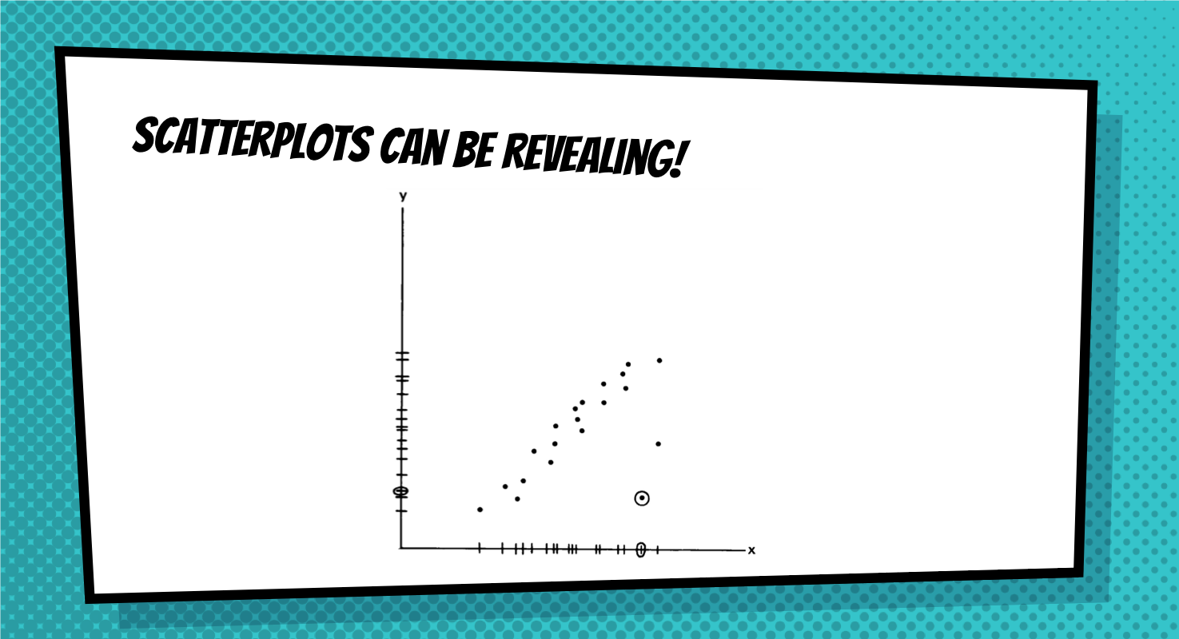

Slide 14
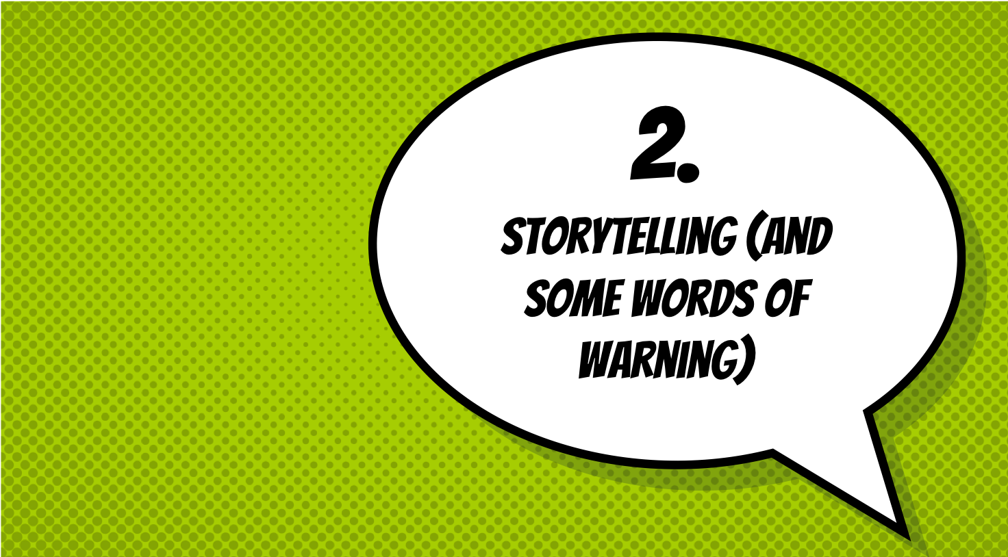

Slide 15


Slide 16
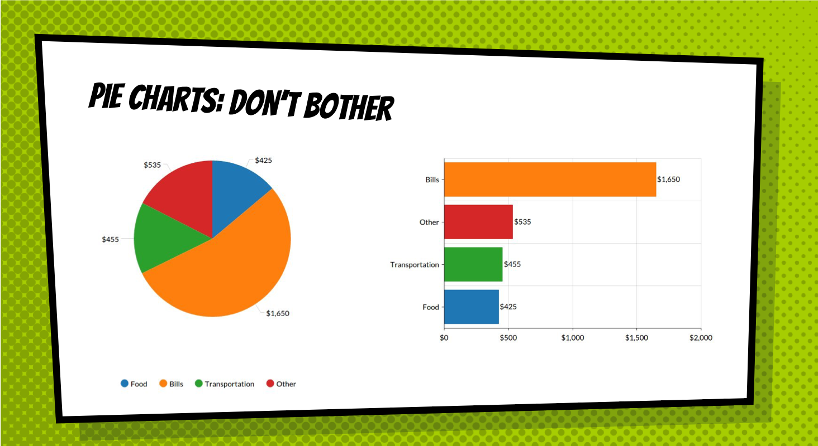

Slide 17
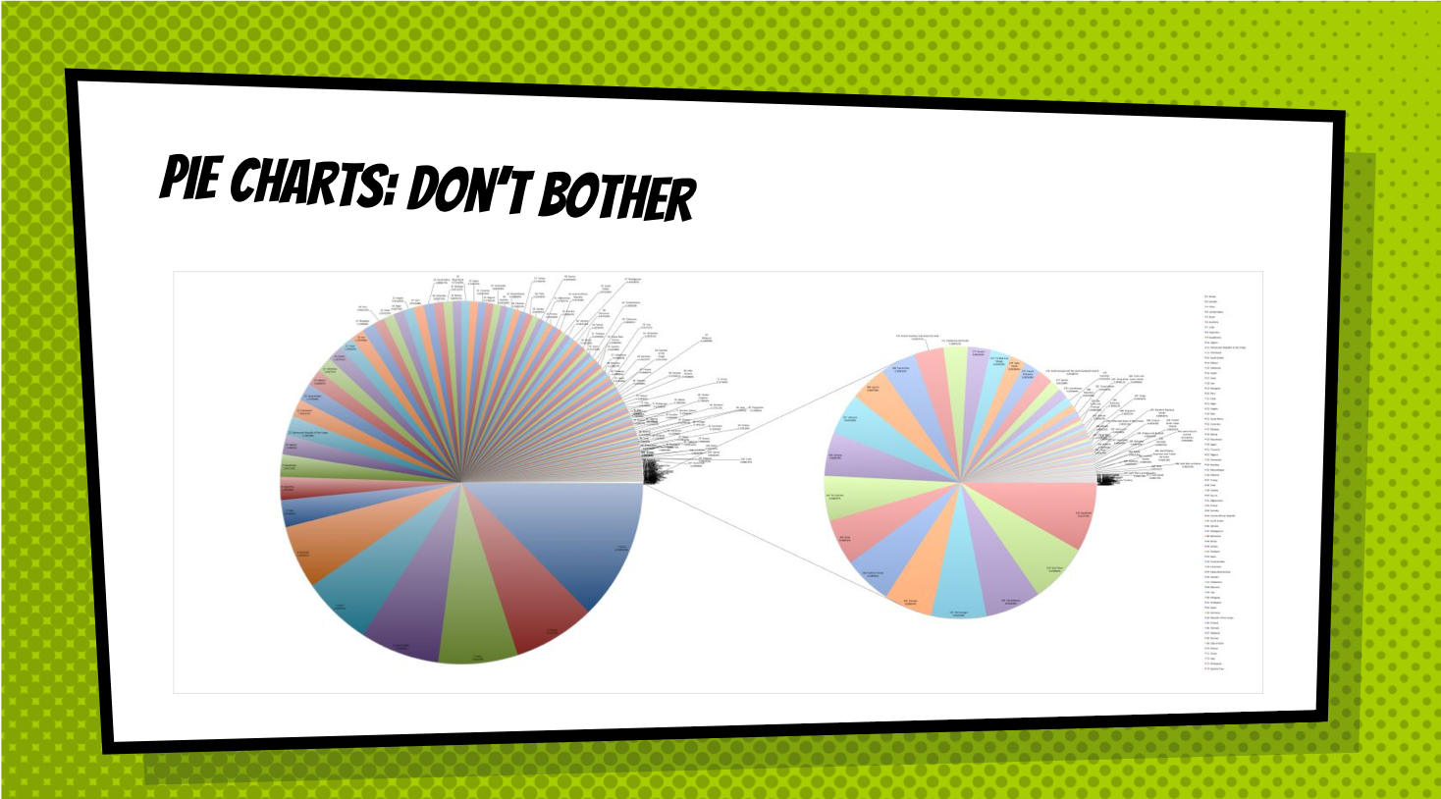

Slide 18
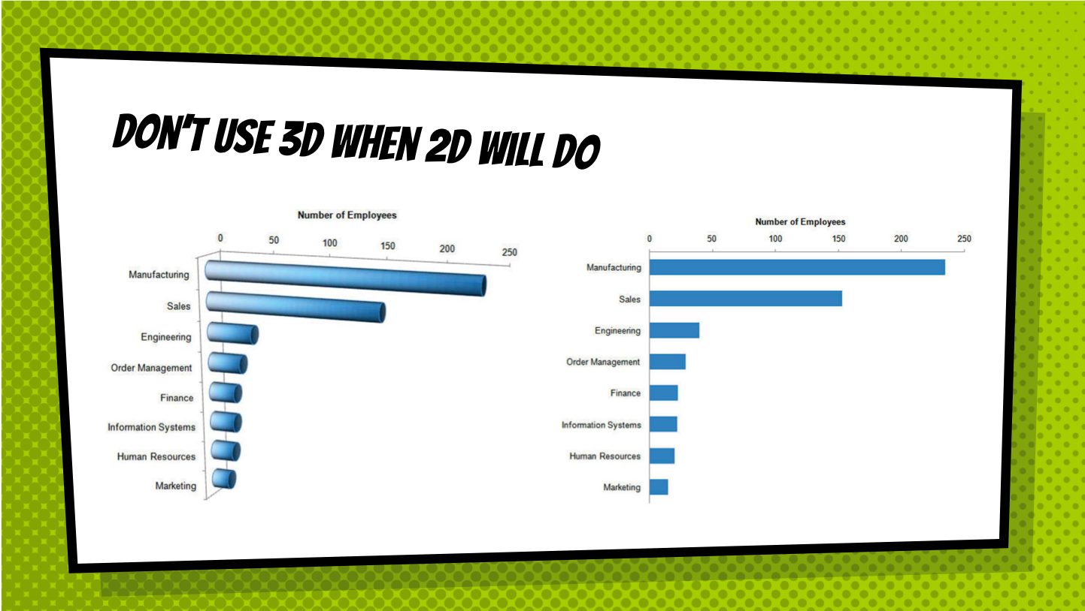

Slide 19
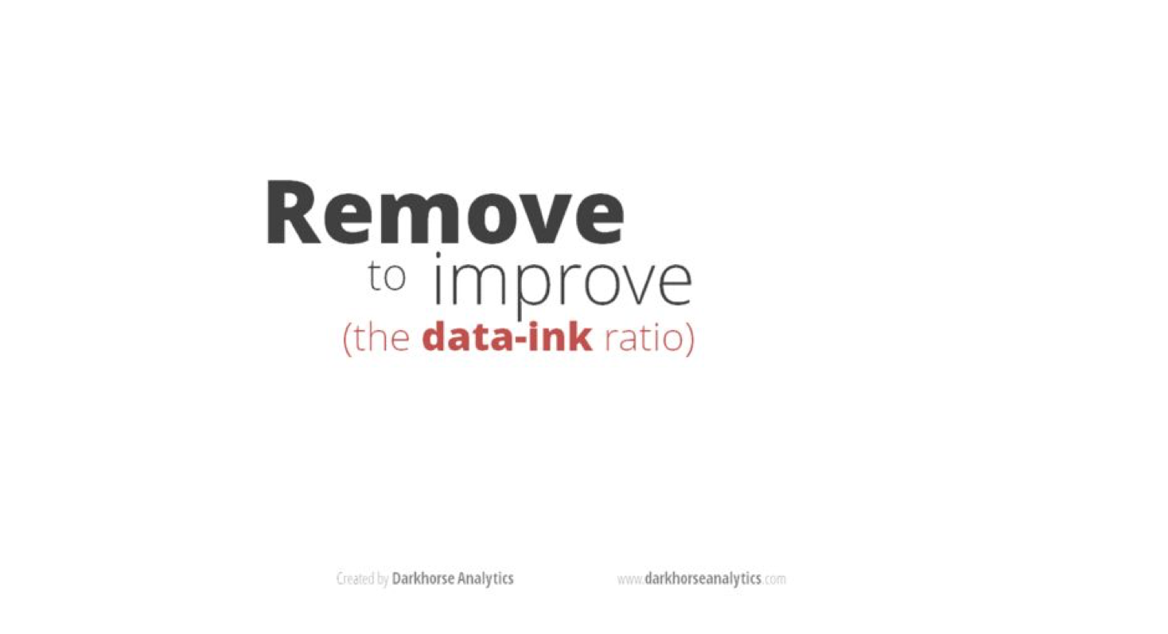

Slide 20
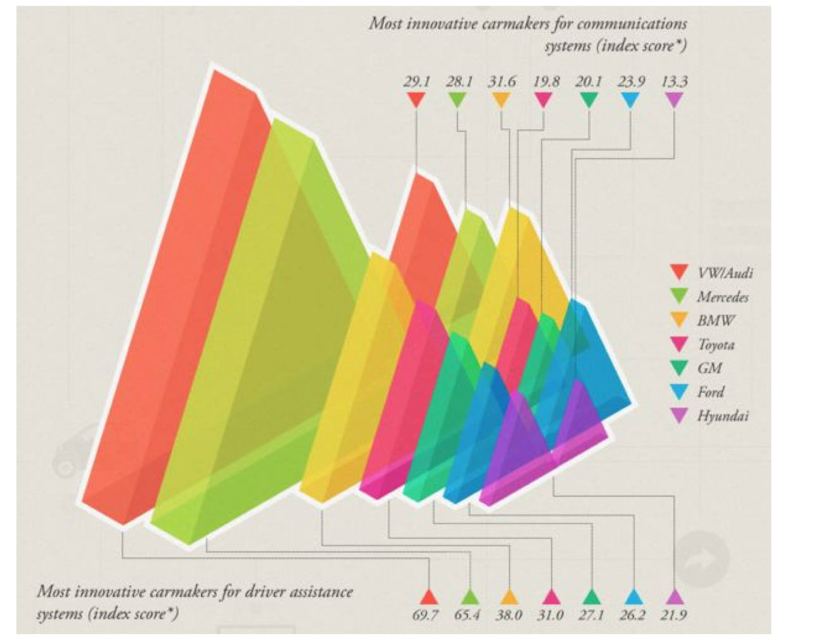

Slide 21


Slide 22
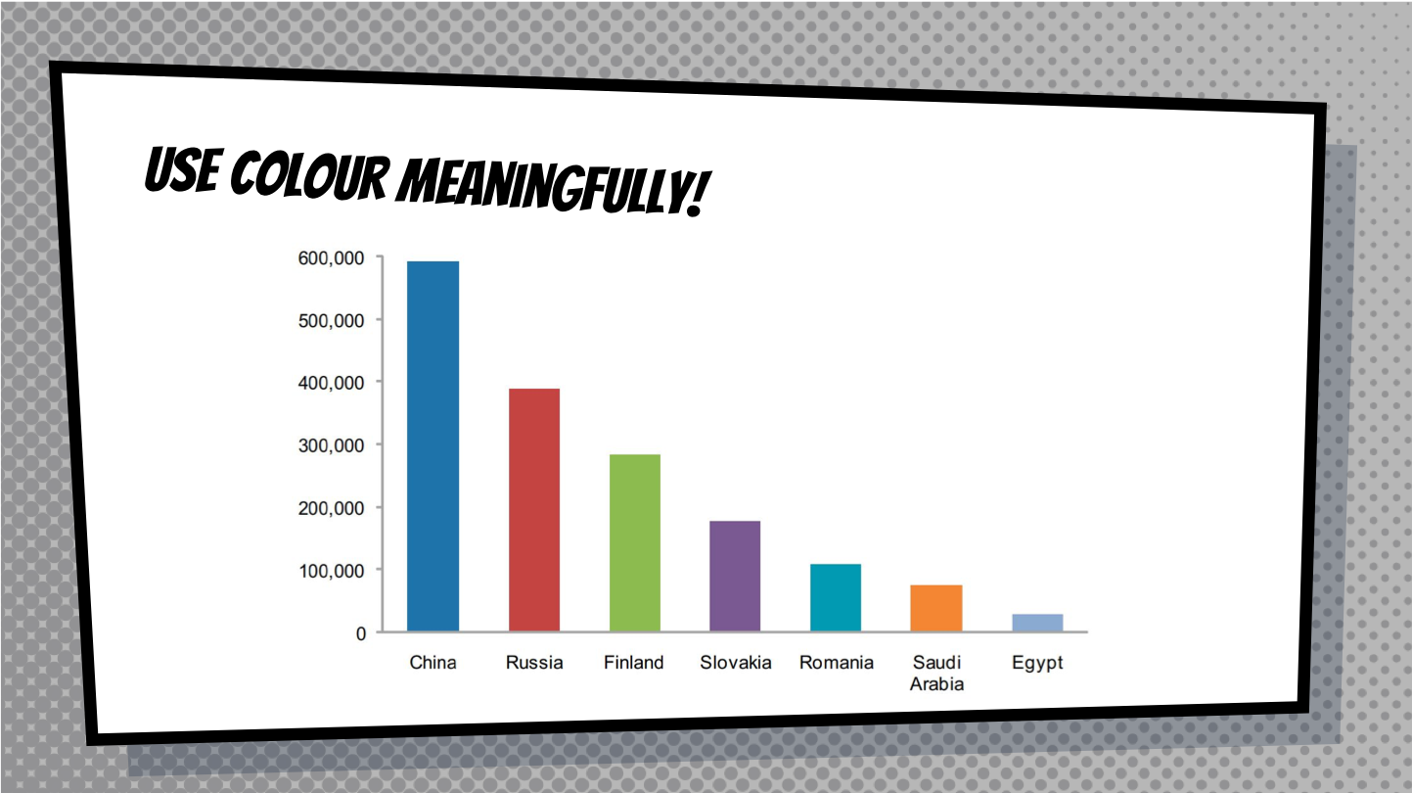

Slide 23
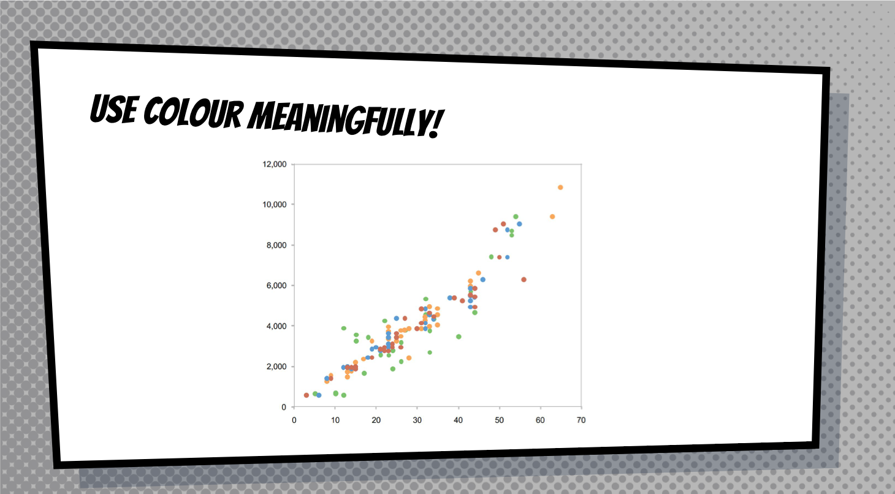

Slide 24
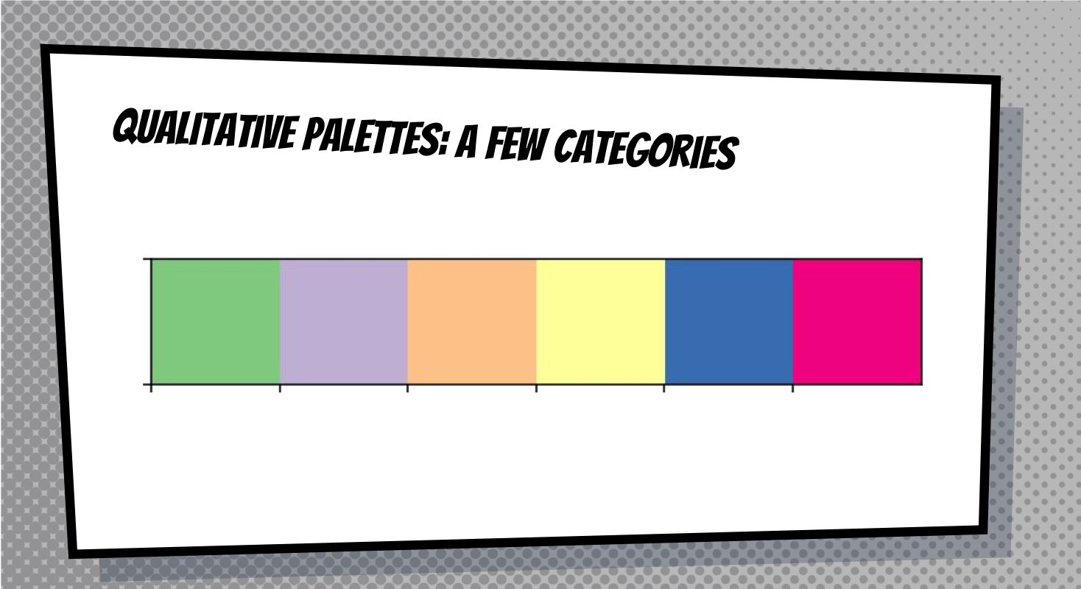

Slide 25
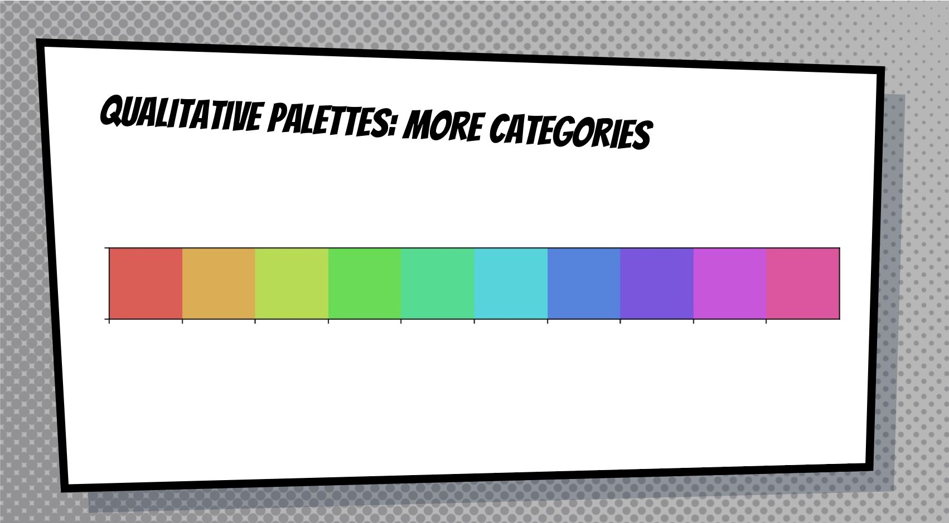

Slide 26
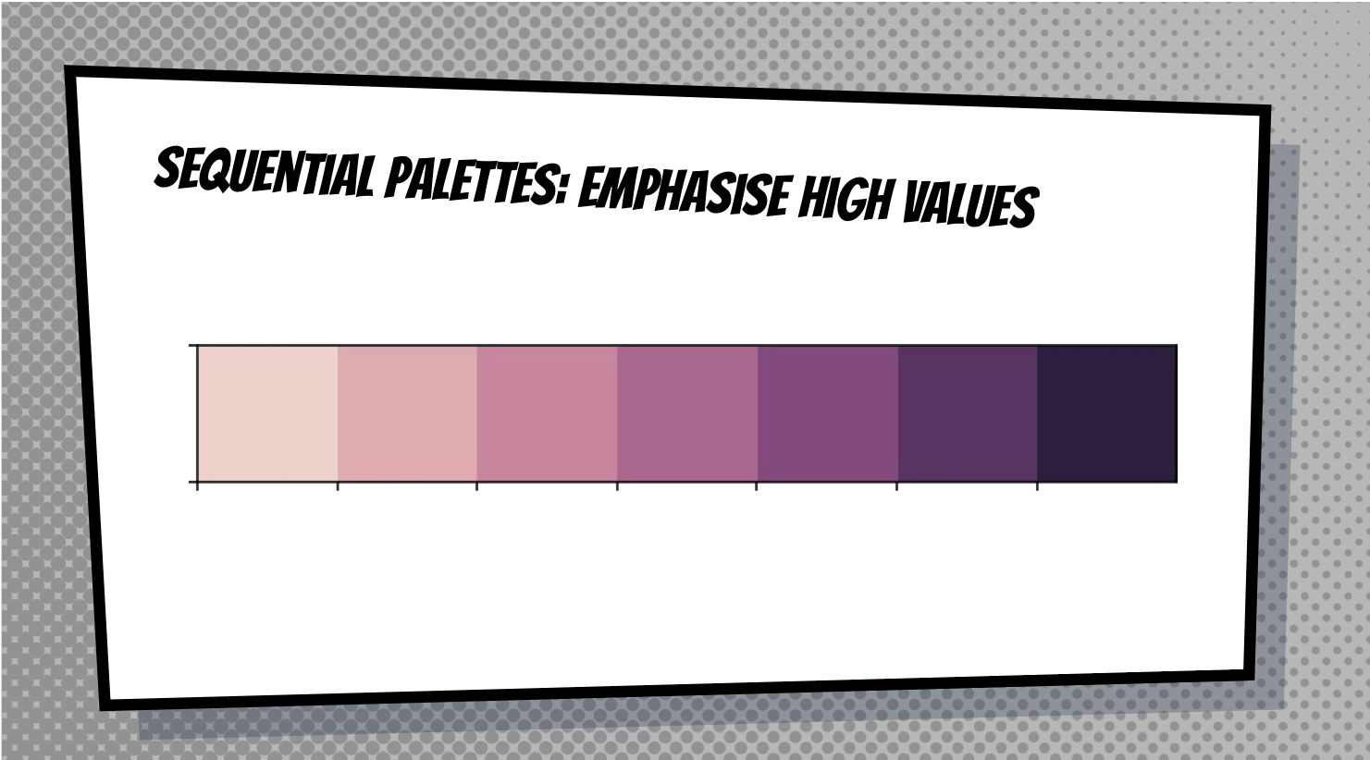

Slide 27
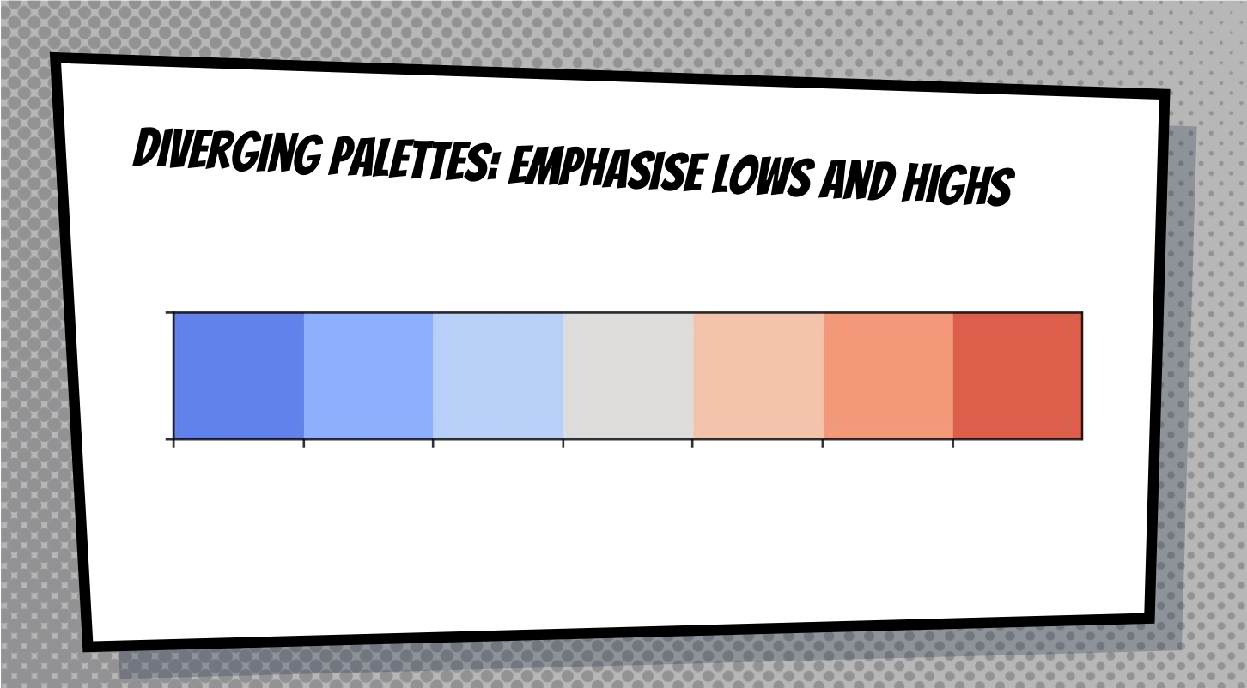

Slide 28
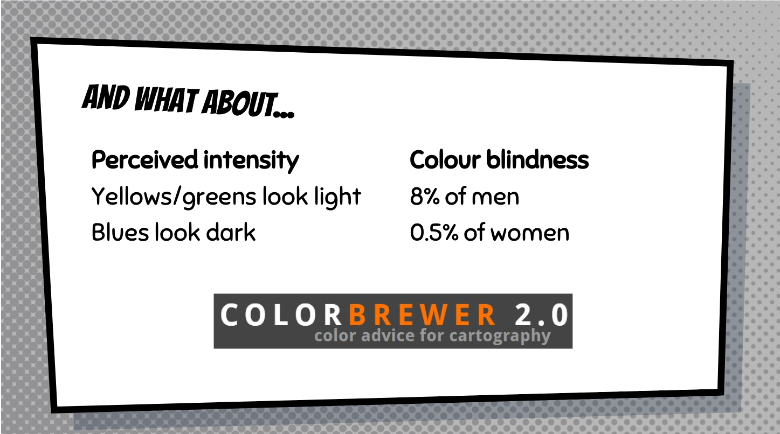

Slide 29
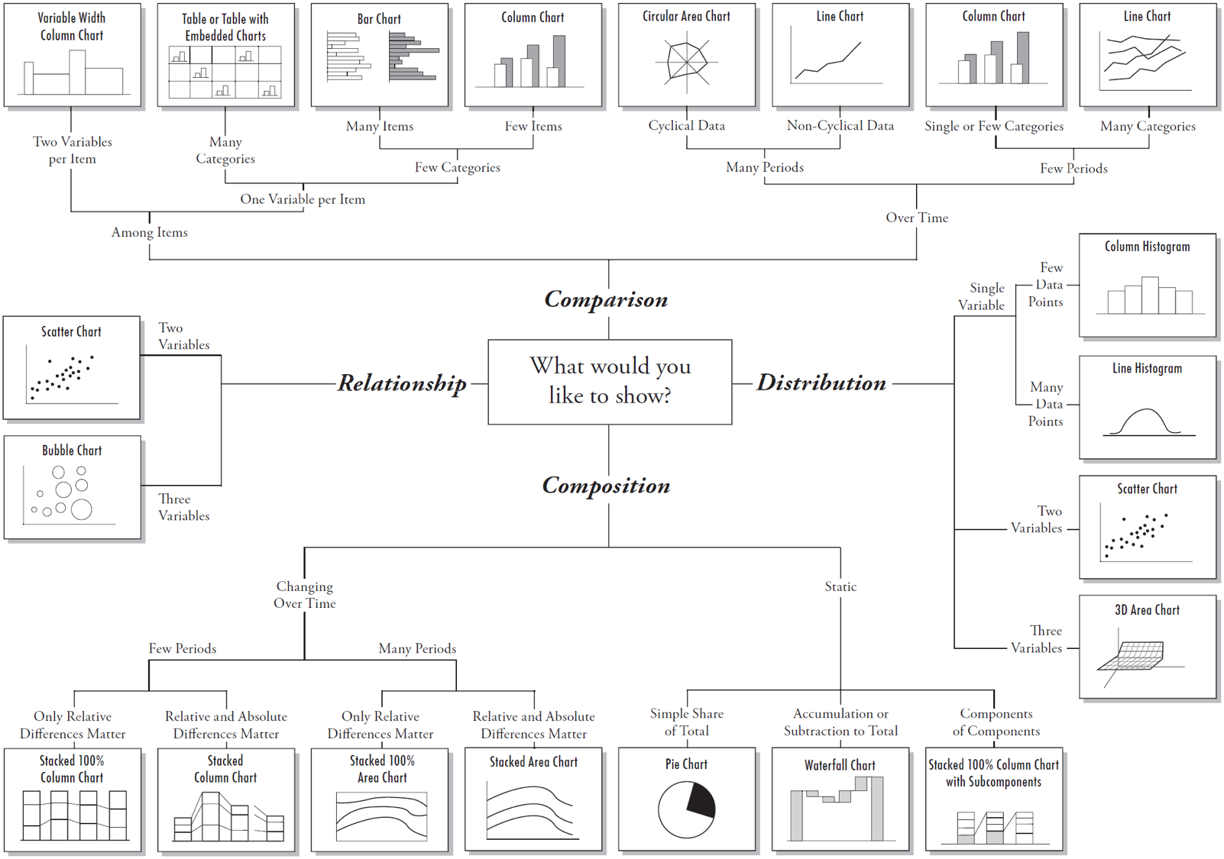
Notes:
Say that though you can’t see this ../Images properly, this image is in the handout.

Slide 30
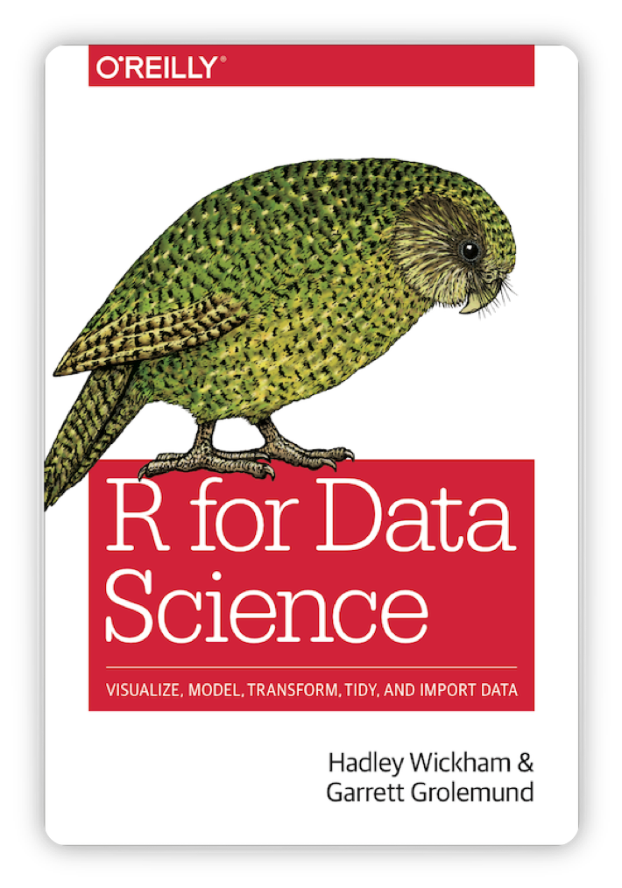
Visualising data in R
This book is helpful
Notes:
We now get to draw graphs!

Slide 31
There are many ways to plot graphs in R
Base R has visualisation commands
ggplot2 package which allows you to ‘layer’ features of graphs
this is what we will use
load it now
library(ggplot2)

Slide 32
Structure of a ggplot command
It takes a while to get used to the structure.
There are different forms of syntax.
Different syntax possible
But in general:
ggplot(data = date_frame_name) + style_of_plot(mapping = aes(x = vector_name1, y = vector_name2))
Notes:
This will become more clear once we see examples

Slide 33
ggplot is very versatile
You can use the same structure for many types of graphs.
ggplot(data = date_frame_name) + style_of_plot(mapping = aes(x = vector_name1, y = vector_name2)) + other_arguments
Notes:
Explain a couple of things you can add on using the + sign.

Slide 34
What is a ‘geom’?
A geom is a visual aspect of a graph.
dots
lines
bars
Look at the ggplot2 cheatsheet for more options.

Slide 35
Create a dot plot
Open up the R script called Workshop5.R. Run through the commands in it. Notice how changing small parts of the main command change the appearance of the graph.
Notice that we use geom_point for a dot plot. We will use other geoms later.
Notes:
There are a lot of commands in the file. Help them load up the file, get the dataset into their environment, and run the commands. Give them a little time to look at the different graphs.

Slide 36
Let’s create a line graph together
ggplot(data = cchic) + geom_smooth(mapping = aes(x = sao2_abg, y = pao2_abg))
Notes:
Get them to type this code in and draw the graph. The graph they should get is on the next slide.

Slide 37
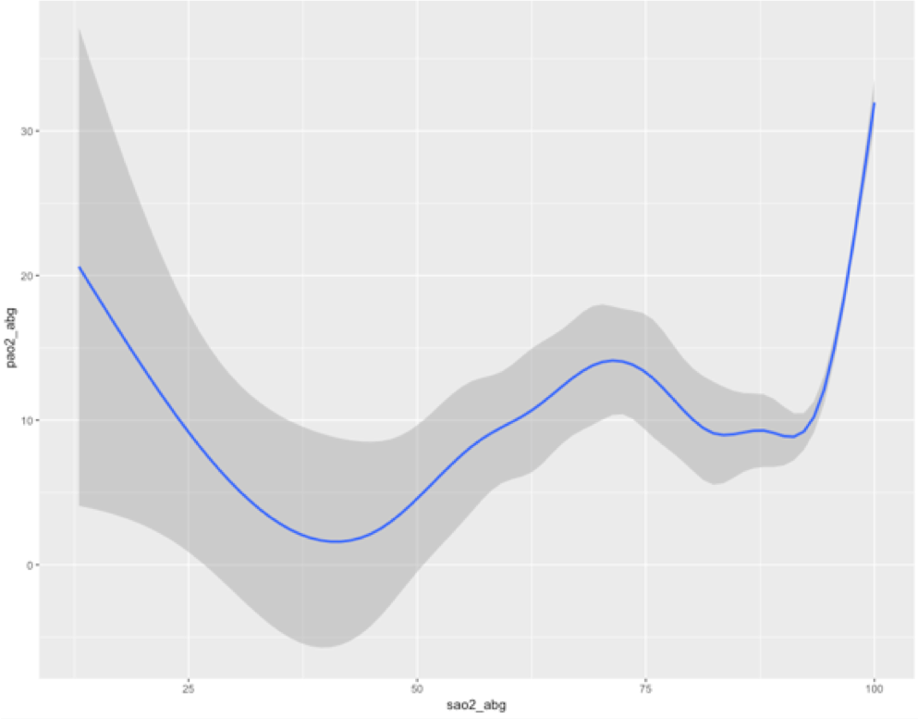

Slide 38
Adding a linetype
ggplot(data = cchic) + geom_smooth(mapping = aes(x = sao2_abg, y = pao2_abg, linetype = sex))

Slide 39
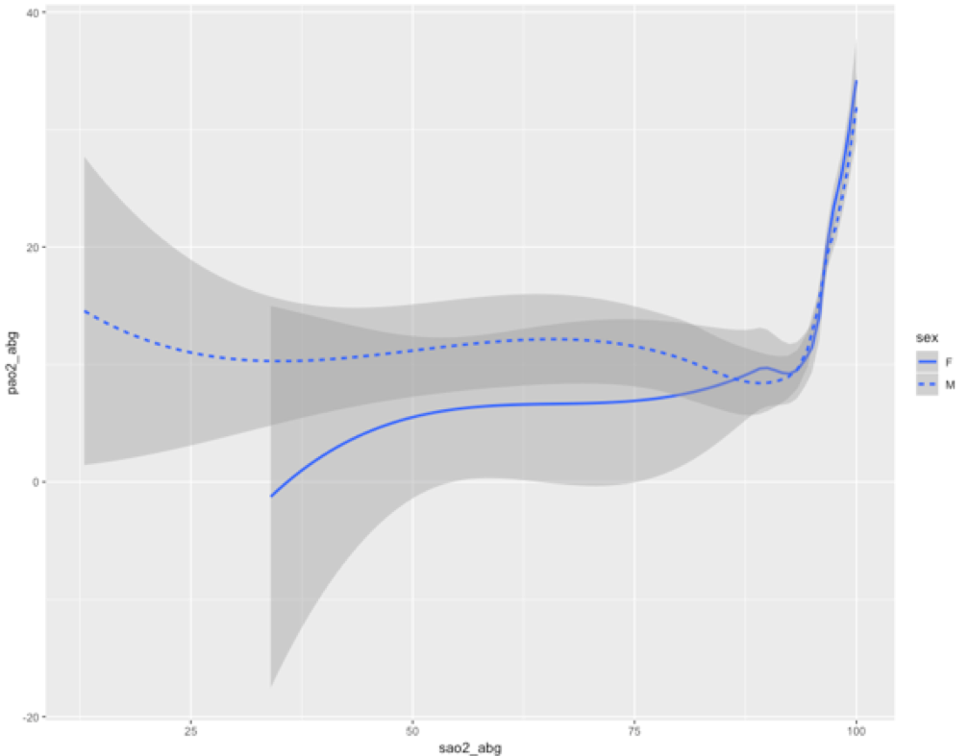

Slide 40
Adding colour
ggplot(data = cchic) + geom_smooth(mapping = aes(x = sao2_abg, y = pao2_abg, colour = sex))

Slide 41
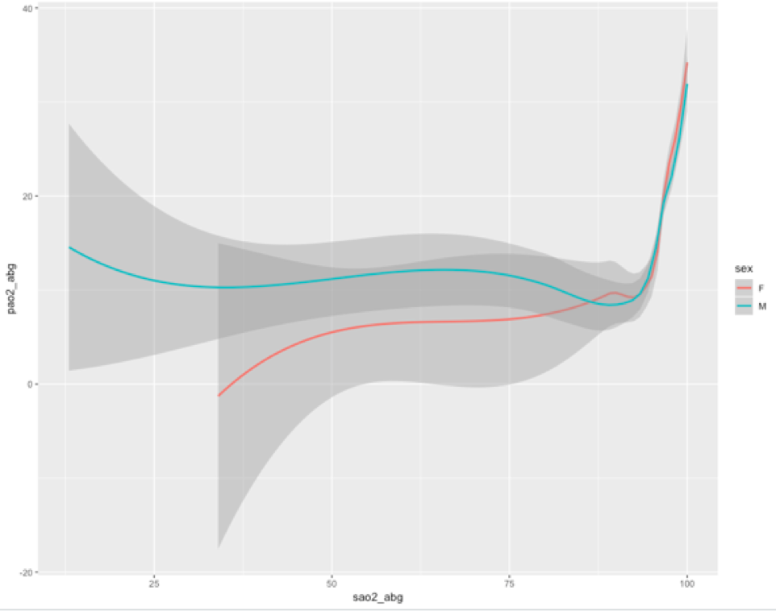

Slide 42
Combining multiple geoms
ggplot(data = cchic) + geom_point(mapping = aes(x = sao2_abg, y = pao2_abg, colour = sex)) + geom_smooth(mapping = aes(x = sao2_abg, y = pao2_abg))

Slide 43
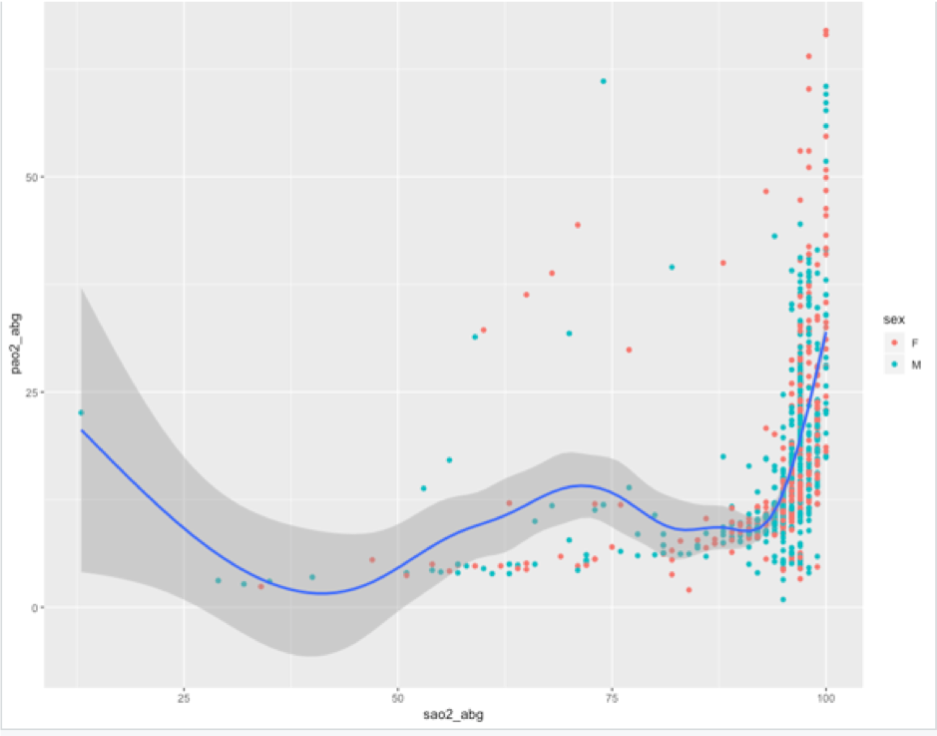

Slide 44
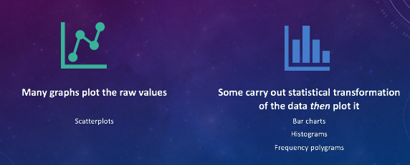
Bar Graph

Slide 45
Drawing a bar graph
geom_bar and stat_count are interchangeable
ggplot(data = cchic) + geom_bar(mapping = aes(x = care_level)) ggplot(data = cchic) + stat_count(mapping = aes(x = care_level))

Slide 46
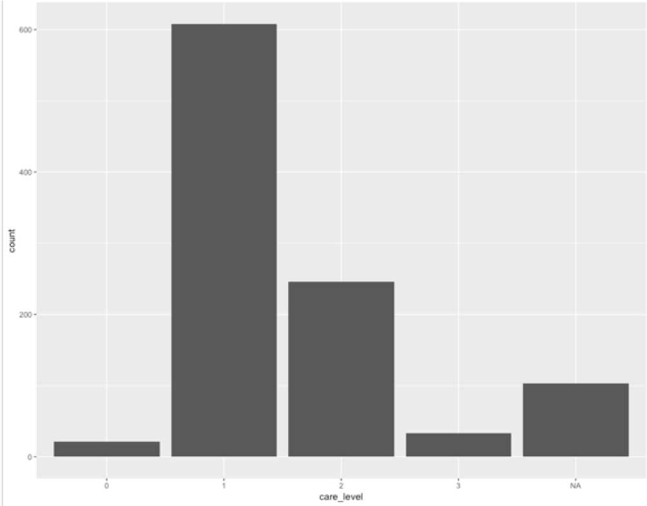

Slide 47
Proportion instead of count
ggplot(data = cchic) + geom_bar(mapping = aes(x = care_level, y = ..prop.., group = 1))

Slide 48


Slide 49
Adding a second aesthetic
ggplot(data = cchic) + geom_bar(mapping = aes(x = care_level, fill = sex))

Slide 50
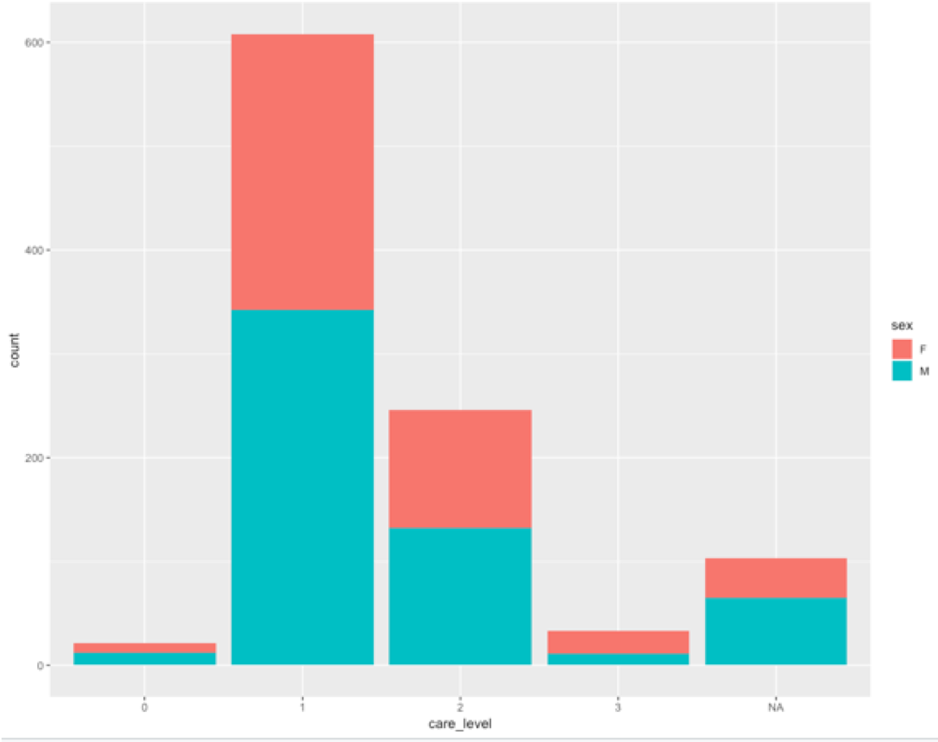

Slide 51
Standardising proportions
ggplot(data = cchic) + geom_bar(mapping = aes(x = care_level, fill = sex), position = "fill")

Slide 52
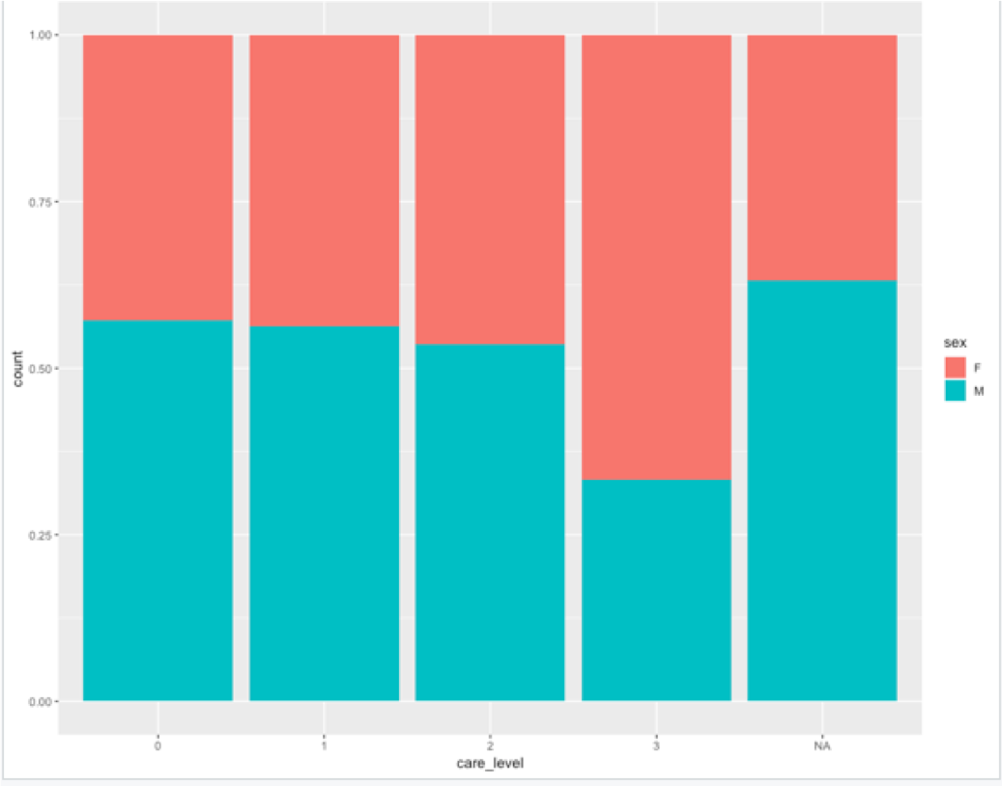

Slide 53
Changing position of bars
ggplot(data = cchic) + geom_bar(mapping = aes(x = care_level, fill = sex), position = "fill")

Slide 54
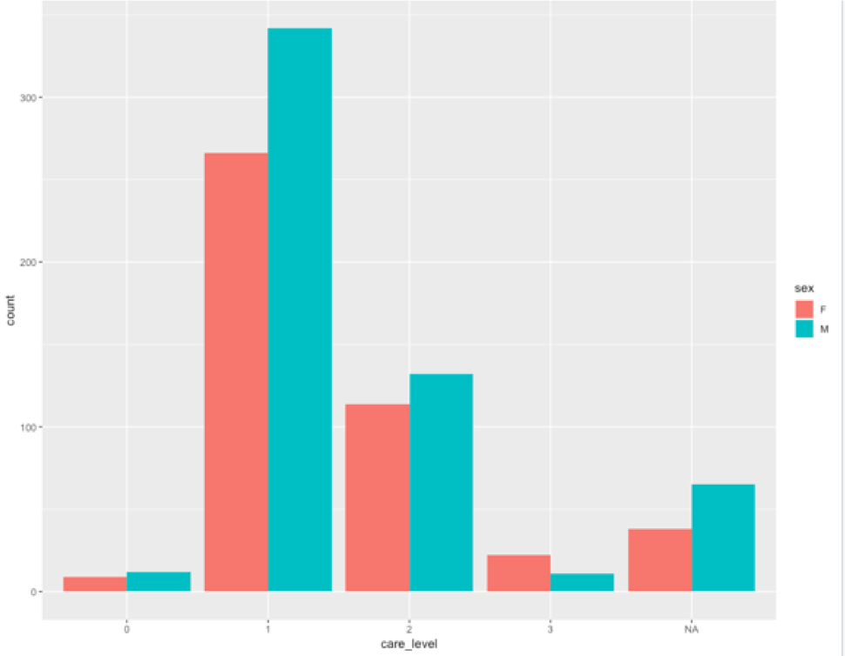

Slide 55
Create your own plots now!

